Slide 1

LENDING CLUB DATA ANALYSIS under the guidance of Professor Yegin Genc
BY
SRAVYA KODAVATI
ARUN YARRAM
CHANDANA NADENDLA

Slide 2

PURPOSE OF THE PROJECT
The purpose of this project is to find out the lendee characteristics by doing exploratory data analysis.
This EDA is done by studying variables like Loan amount, Grade, Installment, term, Employment Length, Loan Status, Address state, Homeownership.

Slide 3
INTRODUCTION
Lending club is a peer-to-peer lending company that matches borrowers with investors through an online platform. It services people that need personal loans between $1,000 and $40,000. Borrowers receive the full amount of the issued loan minus the origination fee, which is paid to the Company. The company shares data about all loans issued through its platform during certain time periods.

Slide 4
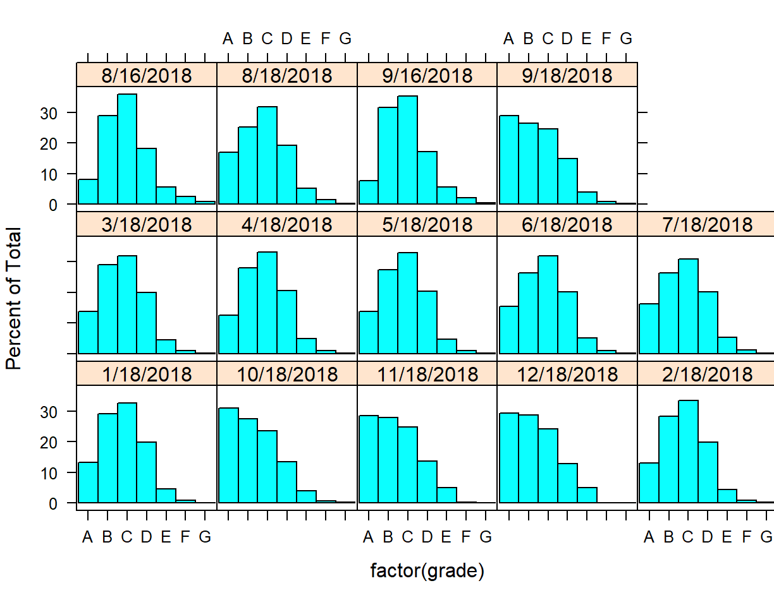
GRADE VARIABLE:
QUESTION: Customers under which grades have highest and lowest no of loans?
This distribution represents grade vs date of loan issued.
In the data visualization, it clearly shows that people who belong to grades E,F,G are least in count of borrowers compared to A,B,C,D.
Loans issued to grades E and F grades customers are least and customers belonging to A,B,C grades are highest.

Slide 5
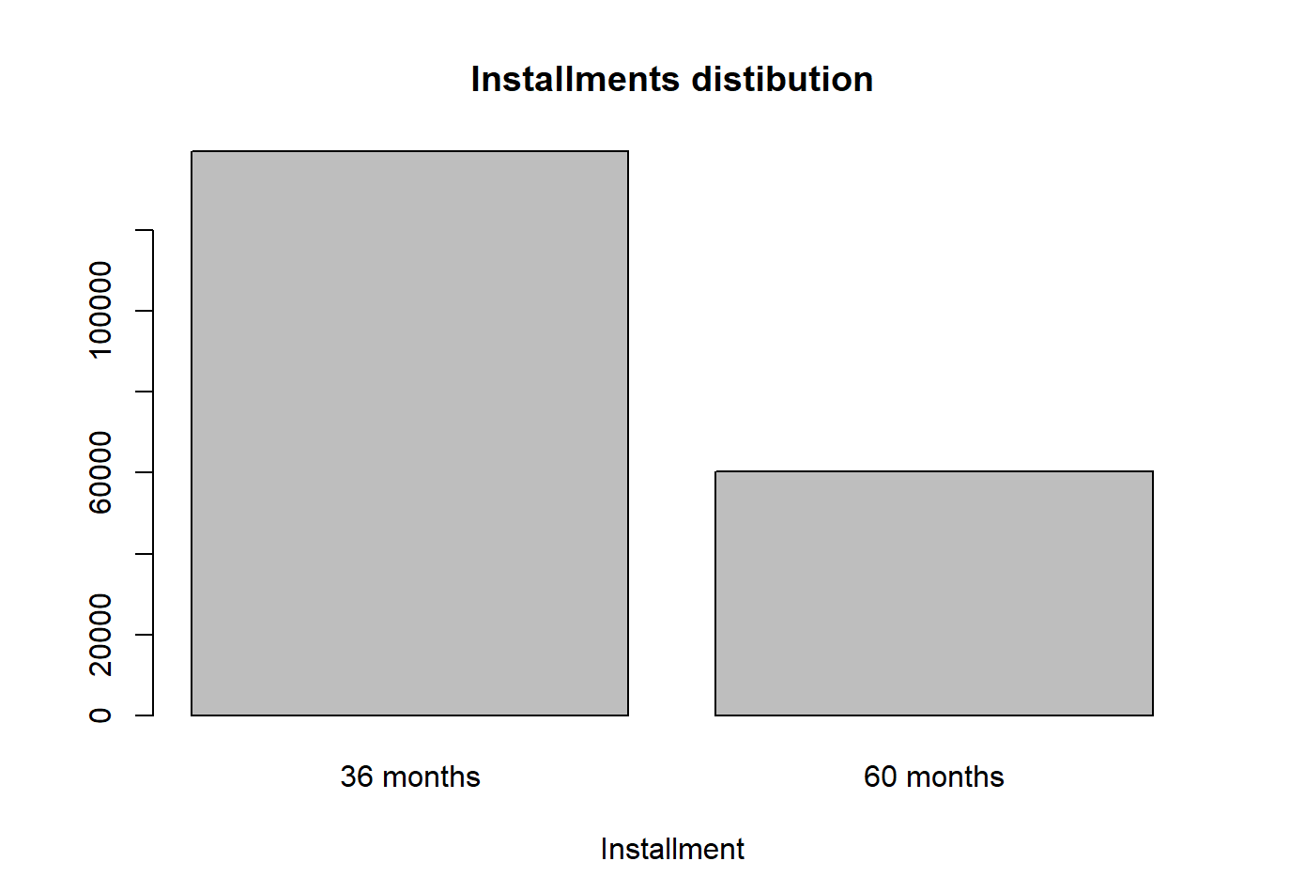
INSTALLMENT VARIABLE:
QUESTION: Which installment term has been opted by customers?
From the visualization we can say that customers are more interested in paying their Emi in short span of time which is 36 months.

Slide 6
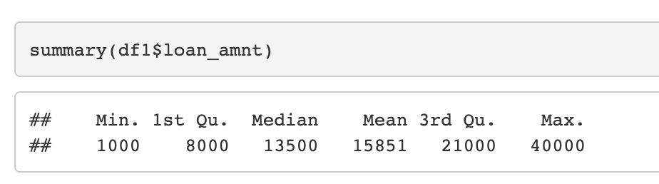
LOAN AMOUNT DISTRIBUTION:
QUESTION:What is the range of loan amount variable?
QUESTION:Which range of loan amount has highest no of customers

Slide 7

Loan Amount Distribution using IQR:
Loan Amount ranges from 1000$-40000$ as per dataset.
From the IQR technique, 50 % of the loan distribution is between 8000$-21000$
25 % of the loan distribution is between 1000$-7999$
25 % of the loan distribution is between 21001$-40000$

Slide 8
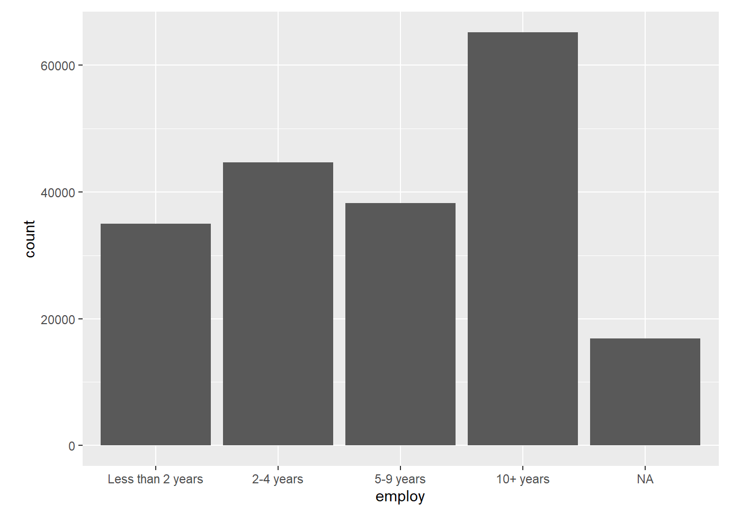
Employment Length Variable:
QUESTION: Which customers are taking highest no of loans by length of employment?
From the Bar chart, customer’s with 10+ years have taken highest no of loans and non-salaried customers have taken lowest no of loans.

Slide 9
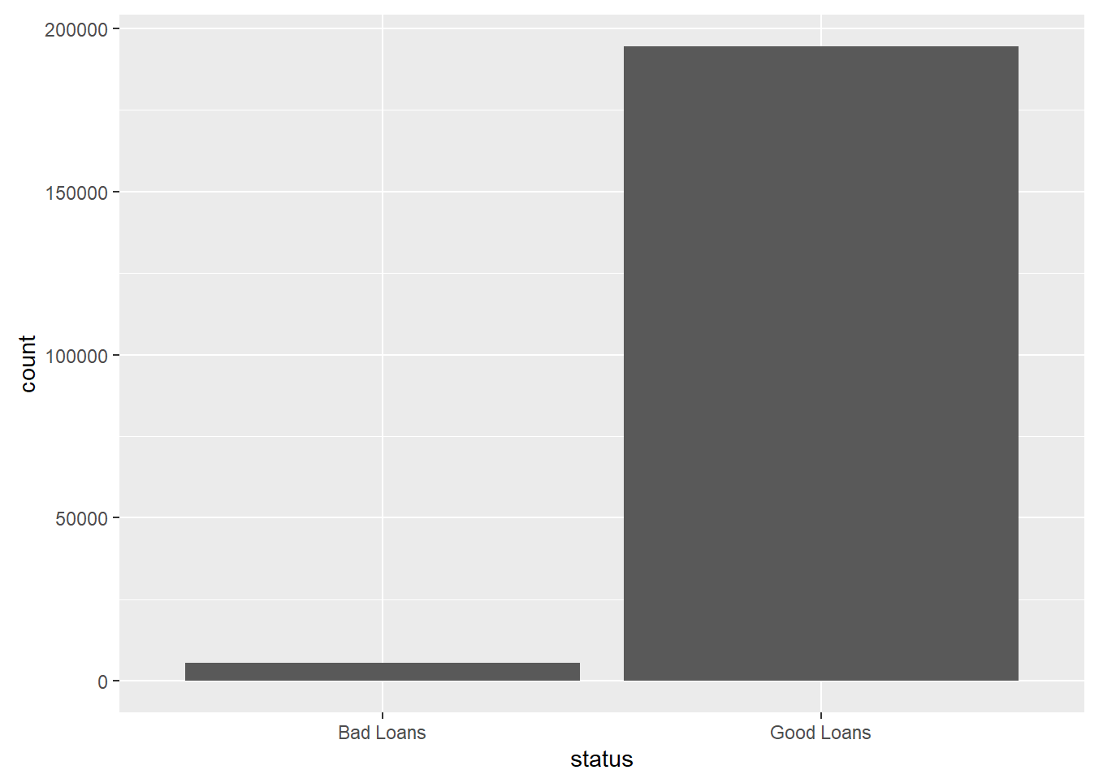
Loan Status Variable:
Customers who are paying the installments regularly are comparatively very high(In real world good loans are more than the bad loans).
Current and Fully paid are considered as ‘Good loans’.
Default, charged off, In grace period, late(16-30 days,31-120 days) are considered ‘Bad loans’.

Slide 10
Issue_d Variable:
QUESTION: Based on issued date variable, which month has highest no of loan amount? Most number of loans are being issued in Oct, Nov, Dec due to the events, sales and offers

Slide 11
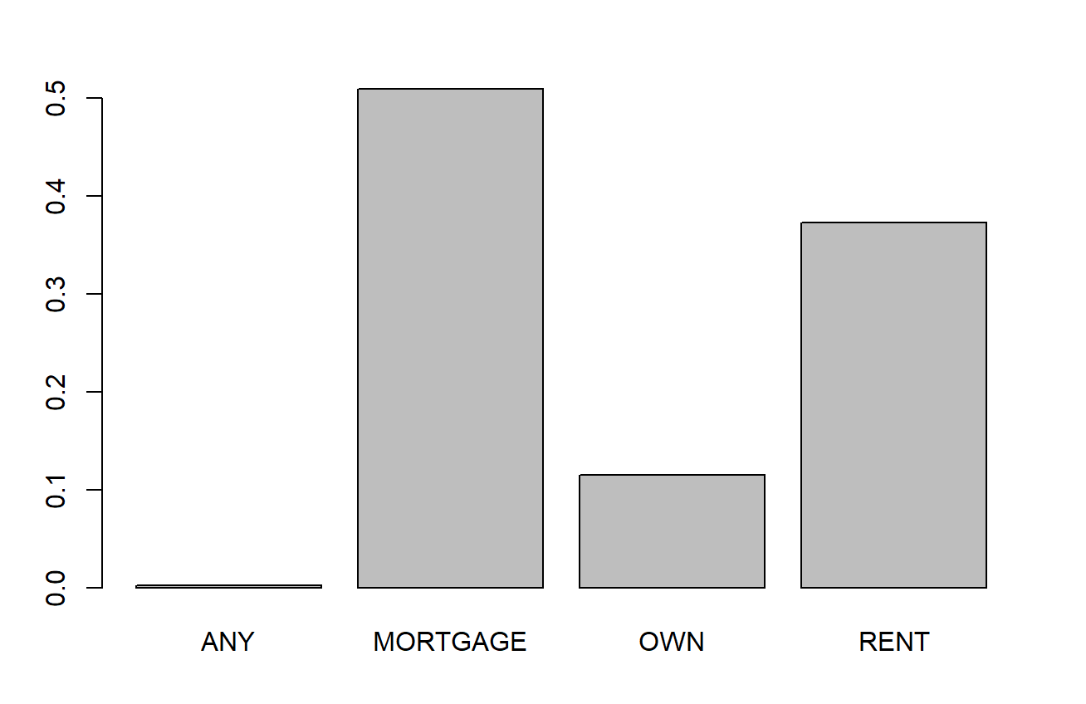
Home Ownership Variable
From the distribution, we can say that customers who are having mortgage loans have taken highest no of loans.

Slide 12
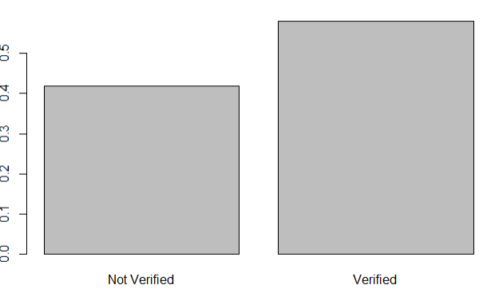
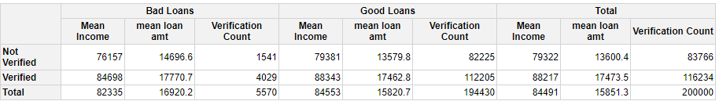
Verification Variable:
QUESTION:Does the applicant needs to be verified to get a loan?
From the plot we can say that most of the customers incomes are verified and one does not need to be verified to get a loan.

Slide 13
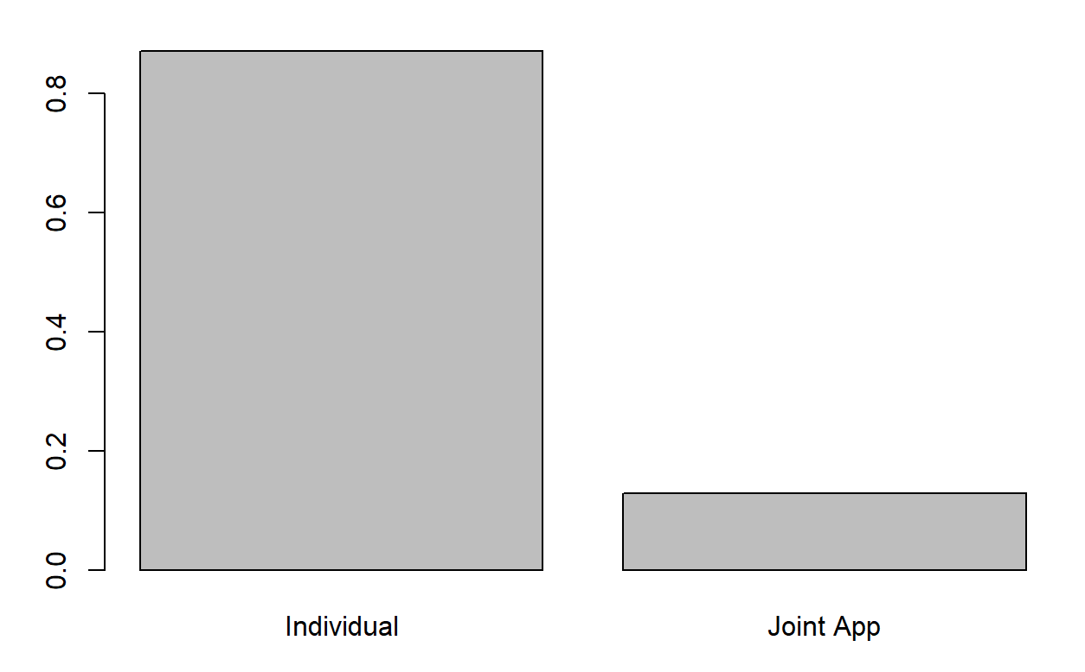
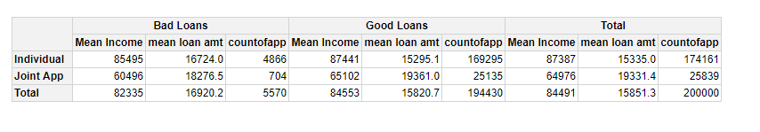
Application Type Variable:
From the barplot, we can say that individual type of applications are more

Slide 14
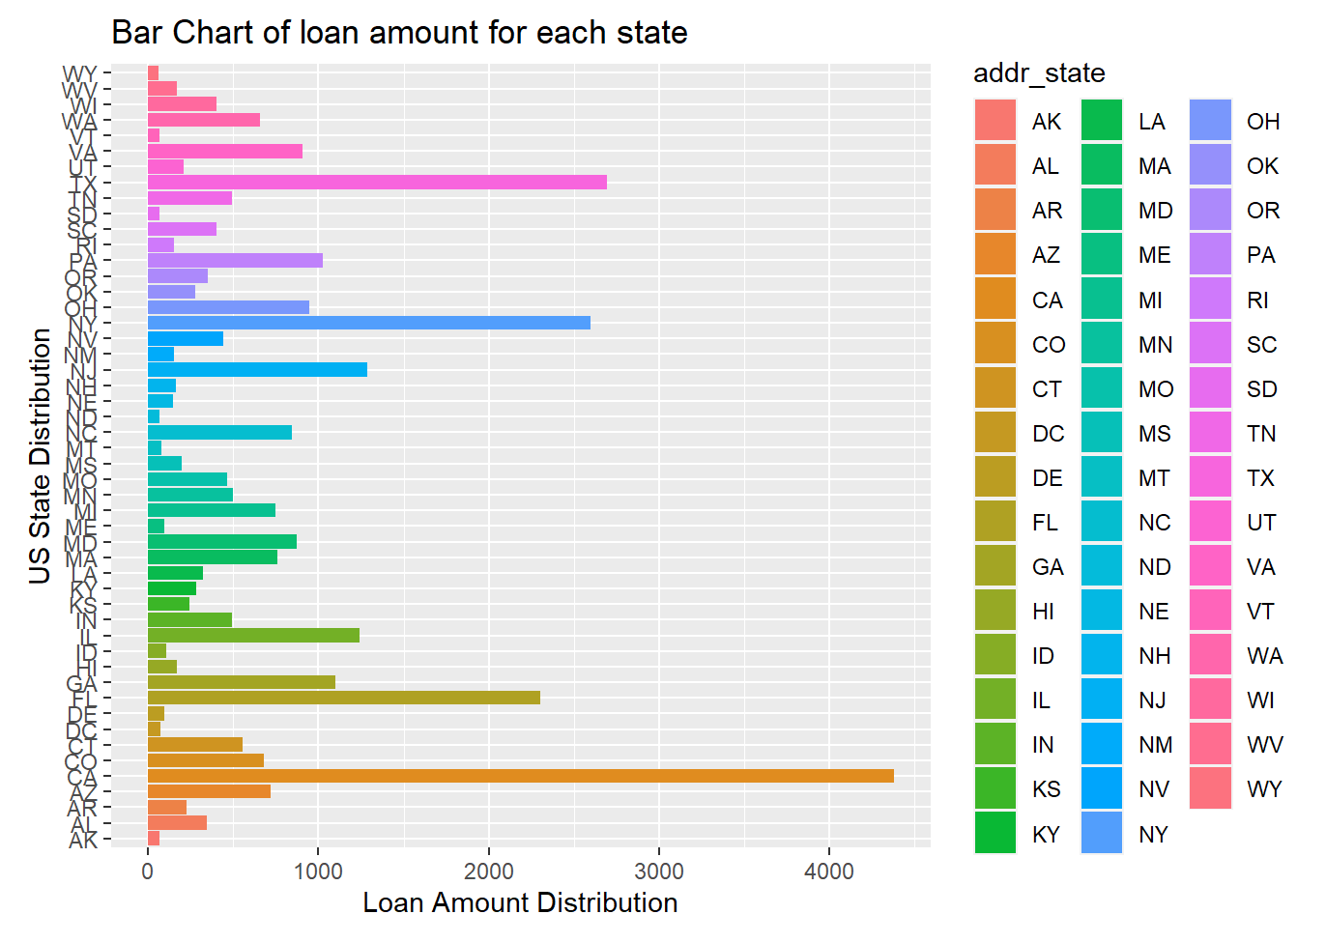
State Variable:
QUESTION: Which states have taken highest no of loans?
From barplot, we can say that California, Texas and New York have highest customers.

Slide 15
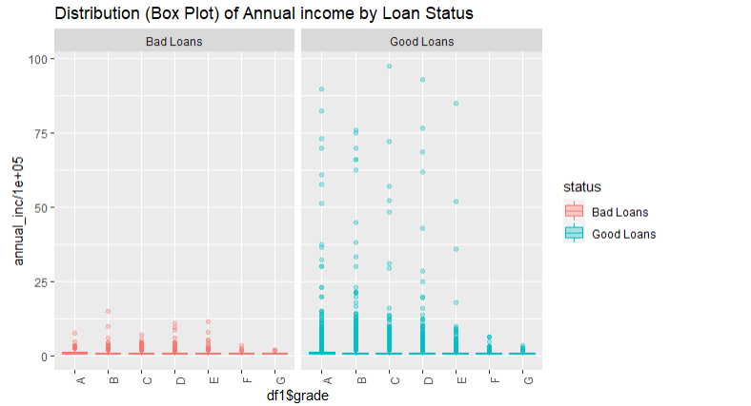
Distribution of Annual income WRT Grades by Status:
QUESTION: How does the loan status affect based on an annual income of a customer with relative to grades?
We can say that the distribution of bad loans income are in fixed ranges with respect to grades compared to good loans, where many outliers are present.

Slide 16
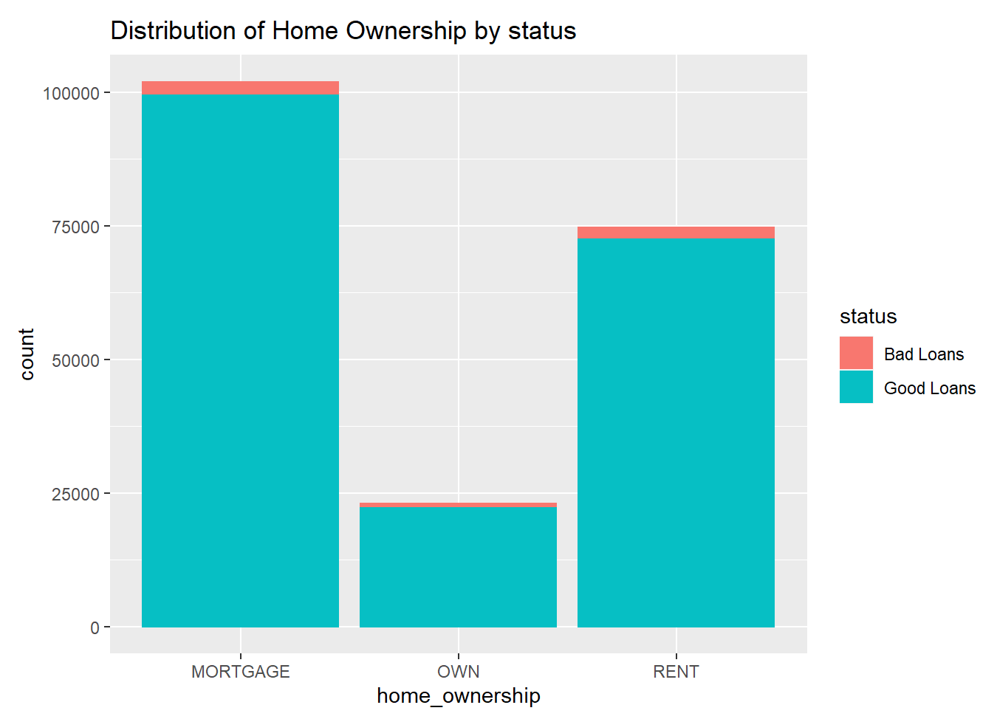
Home_Ownership Variable:
QUESTION: Which category of home ownership affecting the loan status more?
From above stacked Barplot, customers who are in mortgage and rent category are more liable to deliquent.

Slide 17
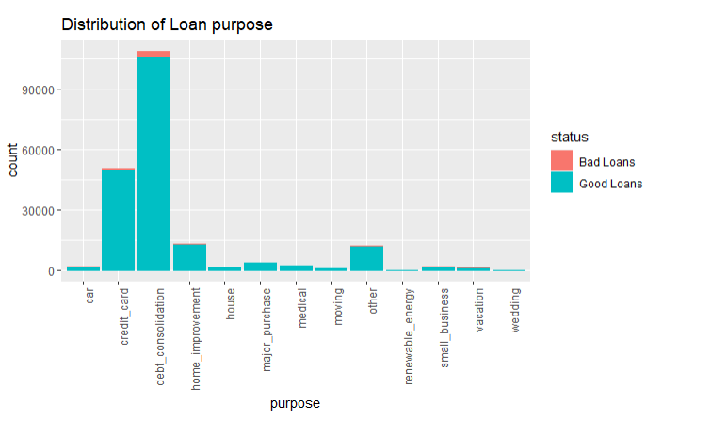
Loan purpose Variable:
QUESTION: For what purpose, highest loans are being issued?
From the stacked barplot, debt_consolidation and credit card purpose have been issued highest no of loans.
Since the loan is being issued more for debt_consolidation and credit card,so there will be more no of bad loans under these purposes.

Slide 18
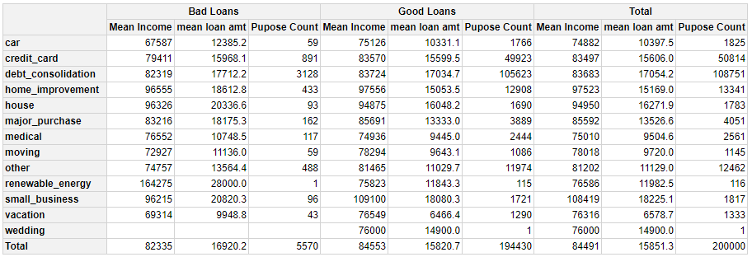
Table Distribution of Purpose v/s Status

Slide 19
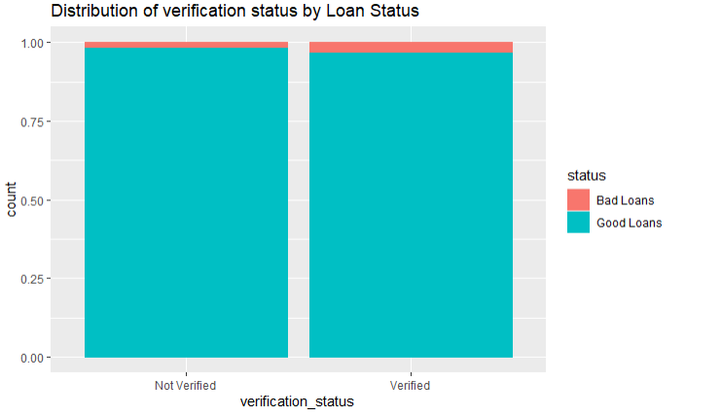
Loan Status v/s Verification Status
Even after the verification is done, there are chances for the customer to be derogatory.

Slide 20
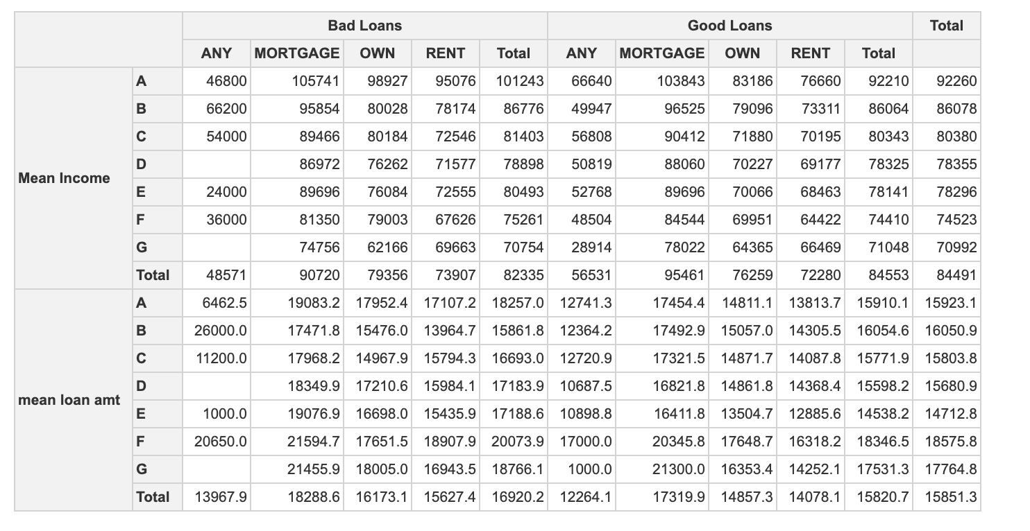
Table Distribution of Status v/s Home Ownership WRT Grades

Slide 21
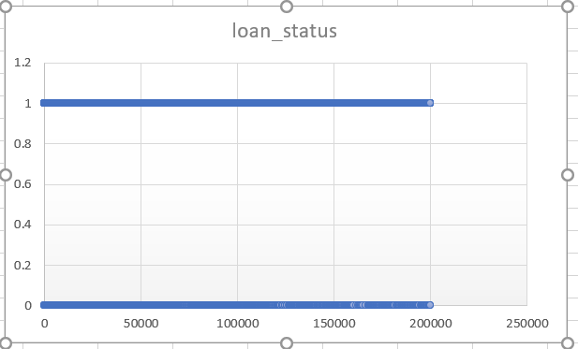
Line Plot of Status:

Slide 22
Conculsion:
In summary we found out the following characteristics for lendees:
Most from CA And TX.
Employed for more than 10 years.
Paying mortgage.
Interested in 36 months term.
Most have taken loans in the months of October, November, December.
Who belong to Grade D and G are consistent in paying loan amount.

Slide 23

THANK YOU

